Slide 1


LEARN AND PLAY FOR CHILDREN WITH DISABILITIES
GROUP MEMBERS:
PRASANNA. I
PREMKUMAR. V
SABARI VIGNESH. L
RADHA KRISHNAN. PR

Slide 2

BRAIN STROMING

Slide 3
KEYWORDS
VISUAL STORYBOARDS
EXPRESSIVE LANGUAGE
BRAILLE THERAPY
MOBILITY AIDS
TACTILE PLAY
GESTURE BASED
ORIENTATION
PHYSICAL THERAPY
SENSORY PLY
VISUAL LEARNING
TACTILE LEARNING
GRASS MOTOR SKILLS
TEAM COLLABORATION
TACTILE PLAI
SENSORY INTEGRATION
OCCUPATIONAL SKILLS
PHNEMONIC CUES
ART AND CRAFT ACTIVITIES
AUDITORY LEARNING
ACCESSIBLE PLAYGROUND

Slide 4
MIND MAPPING

Slide 5

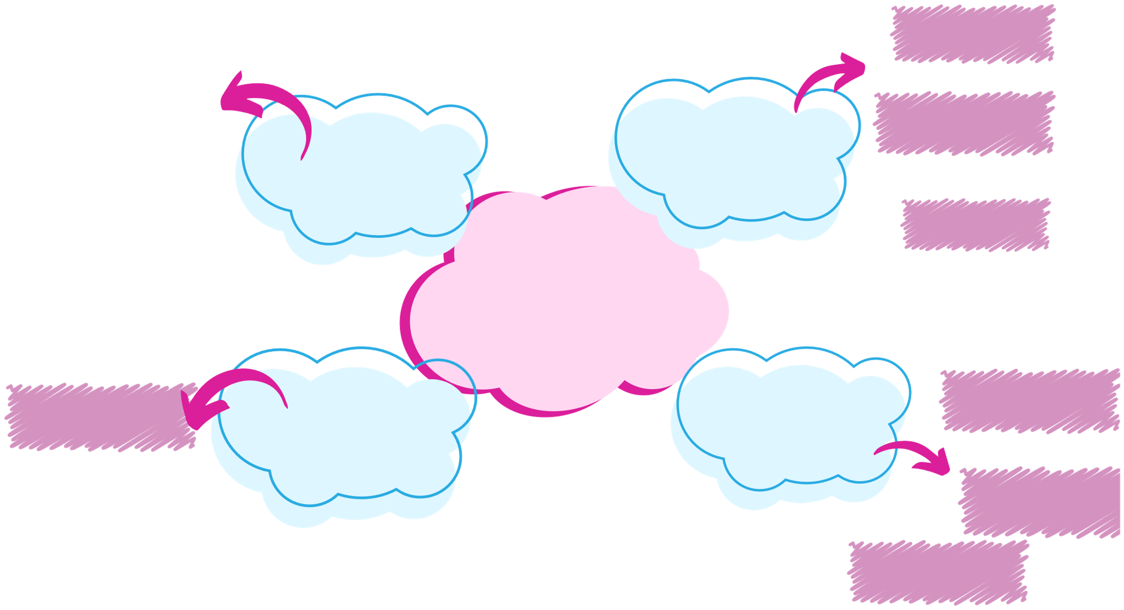




ACCESSIBILITY
COGNITIVE SKILLS
CUSTOMIZATION
MOTOR SKILLS
LEARNING OBJECTIVES
GAME FEATURES
REWARDS SYSTEM
SOCIAL SKILLS
LEARN AND PLAY FOR CHILDREN WITH DISABILITIES
EDUCATIONAL GAMES
PARENTAL CONTROLS
PROGRESS TRACKING
GAME TYPES
INTERACTIVE
STORIES
CONTENT MANAGEMENT
CREATIVE PLAY
HELP SECTION

Slide 6
5W-S AND 1H QUESTIONS

Slide 7

Category
Deaf
Who will use the app? (e.g., children with hearing impairments)
Dumb
Who will use the app? (e.g., children with speech impairments)
Blind
Who will use the app? (e.g., children with visual impairments)
Physical Disabilities
Who will use the app? (e.g., children with mobility impairments)
Who
What features are needed? (e.g., visual cues, subtitles)
What features are needed? (e.g., text-to-speech, communication boards)
What features are needed? (e.g., audio descriptions, tactile feedback)
What features are needed? (e.g., adaptive controls, ergonomic design)
What
When will it be used? (e.g., during learning sessions, at home)
When will it be used? (e.g., during therapy, at school)
When will it be used? (e.g., during playtime, in classrooms)
When will it be used? (e.g., during physical therapy, at home)
When
Where will it be used? (e.g., at home, in schools, in therapy centers)
Where will it be used? (e.g., at home, in speech therapy sessions)
Where will it be used? (e.g., at home, in schools, in therapy centers)
Where will it be used? (e.g., at home, in schools, in therapy centers)
Where
Why is it needed? (e.g., to support learning, to enhance communication)
Why is it needed? (e.g., to support communication, to enhance learning)
Why is it needed? (e.g., to support learning, to enhance accessibility)
Why is it needed? (e.g., to support mobility, to enhance learning)
Why
How will it work? (e.g., through visual aids, sign language support)
How will it work? (e.g., through text-to-speech, visual aids)
How will it work? (e.g., through audio cues, tactile interfaces)
How will it work? (e.g., through adaptive controls, ergonomic design)
HOW

Slide 8

USER PARTICIPANT
MAPPING

Slide 9


QUATERNARY USES AUGMENTED REALITY BIOFEEDBACK GAMES CODING TOYS WEARABLE TECH
TERTIARY USES VIRTUAL REALITY ROBOTICS KITS LANGUAGE APPS SOCIAL STORIES
SECONDARY USES MUSIC THERAPY ART SUPPLIES PUZZLE GAMES ADAPTIVE SPORTS
PRIMARY USES INTERACTIVE STORYBOOKS SENSORY TOYS EDUCATIONAL APPS BUILDING BLOCKS

Slide 10

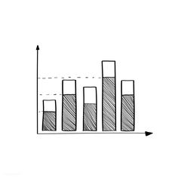
DEMO - GRAPHICS

Slide 11
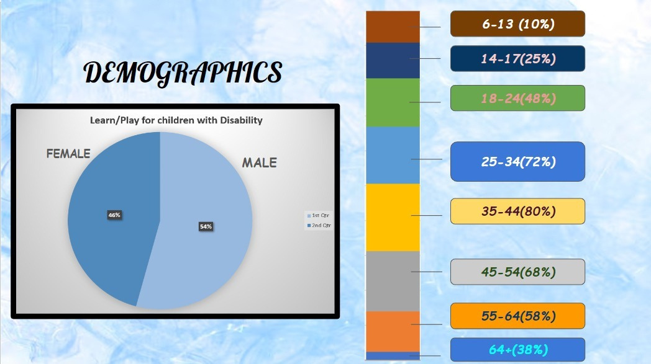
18-24(48%)

Slide 12

QUESTIONNAIRES &
CUE CARDS

Slide 13
Emotion Cue cards
Preference Cue Cards
How did you feel about this activity?
🥳 Happy
😐 Okay
😖 Frustrated
💤 Bored
😟 Scared
What activities do you like best?
🎨 Art
🧩 Puzzles
🎶 Music
🏃 Running/Outdoor Games
🤹Sensory Play
Difficulty Level Cue Cards
Goal Achievement Cue Cards
How easy or hard was this activity for you?
😌 Very Easy
😊 Easy
😬 A Little Hard
😣 Hard
Do you feel like you are getting better at [specific skill]?
🌟 Yes, I’m improving a lot
👍 Yes, I’m improving a little
🤷 Not sure
👎 No, not really

Slide 14
ARTIFACTS,ACTIVITIES &
SPATIAL MAPPING

Slide 15
Artifacts: Adaptive tools and resources
Examples: Cue cards, sensory toys, communication boards, timers, weighted blankets.
Activities: Types of activities tailored for developmental needs
Examples: Sensory play, social games, movement exercises, art/music, problem-solving.
Spatial Mapping: Environment setup for accessibility and engagement
Zones: Sensory zones, quiet corners, active play spaces, creative areas, routine zones.
Learn and Play Program for Children with Disabilities

Slide 16

OIOR TABLE

Slide 17
Observation | Inference | Opportunities | Recommendations
Children engage with visual cues but need them simple and consistent. | Clear visuals support understanding, while complex ones may confuse. | Standardize cue cards and instructions across activities. | Develop icon-based cue cards and train staff in their consistent use.
Caregivers want regular updates on progress. | Updates help caregivers feel engaged and informed. | Use a digital tool to share weekly visual progress updates. | Create a tool for sharing quick updates and at-home support activities.
Transitions cause anxiety for some children. | Preparation helps ease transition stress. | Use visual timers and pre-transition cues. | Integrate “transition” cue cards and timers to indicate activity changes.
Educators need adaptive tools and training. | Resources help educators support diverse needs better. | Increase training and access to sensory and communication aids. | Develop a resource plan and regular training on adaptive strategies.

Slide 18
THANK YOU

